Slide 1












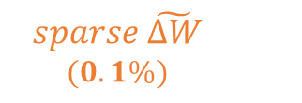


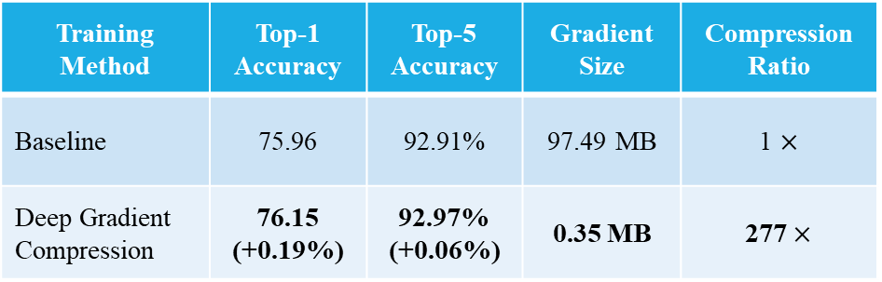











Deep Gradient Compression:
Reducing the Communication Bandwidth for Distributed Training
Yujun Lin¹, Song Han^{2,3 *}, Huizi Mao², Yu Wang¹, William J. Dally^{2,4}
1. Tsinghua University 2. Stanford University 3. Google Brain 4. NVIDIA * joining MIT in 2018
Local Gradient Accumulation
Momentum Correction
Momentum Factor Masking
$$Parameter Server$$
$${m⋅u}_{k, t+1}$$
Table 2: ResNet-50 on ImageNet Dataset
Table 1: AlexNet on ImageNet Dataset
Update
$$sparse \tilde{ΔW}$$
$$(0.1\%)$$
$$ΔW$$
$$ΔW$$
$$u_{k,t+1}$$
$$u_{k,t+2}$$
Training Method | Top-1 Accuracy | Top-5 Accuracy | Gradient Size | Compression Ratio
Baseline | 58.17% | 80.19% | 232.56 MB | 1 $×$
TernGrad [2] | 57.28% (-0.89%) | 80.23% (+0.04%) | 29.18 MB | 8 $×$
Ours | 58.20% (+0.03%) | 80.20% (+0.01%) | 0.39 MB | 597 $×$
$$u_{k,t+1}$$
Training Method | Top-1 Accuracy | Top-5 Accuracy | Gradient Size | Compression Ratio
Baseline | 75.96 | 92.91% | 97.49 MB | 1 $×$
Deep Gradient Compression | 76.15 (+0.19%) | 92.97% (+0.06%) | 0.35 MB | 277 $×$
$$∇_{k,t+1}$$
$$∇_{k,t+1}$$
$$∇_{k,t+2}$$
$$thr=top 1/1000$$
…
$${m⋅u}_{k,t}$$
…
$$∇_{k,t+T}$$
$$∇_{k,t}$$
$$∇_{k,t}$$
$$u_{k,t+1}$$
$$u_{k,t+1}$$
Update
Data
Data
Data
Data
Data
Data
Data
Data
Data
Data
$$⋯$$
$${m⋅u}_{k, t−1}$$
$${m⋅u}_{k, t−1}$$
More Training Nodes
Deep Gradient Compression
$$∇_{k,t+1}$$
Local Gradient Clipping
Warm-up Training
Time:
computation
computation
comp.
communication
communication
Sparsity
c.
$thr_{{\left|G_{k,t}\right|}_{2}}=N^{−1/2}⋅thr_{{\left|G_{t}\right|}_{2}}$
$$∇_{k,t}$$
$$Node k$$
Epoch
Notes:
Large-scale distributed training improves the productivity of training deeper and larger models. [-][-] Gradient exchange is costly and dwarfs the savings of computation time. [-]Deep Gradient Compression solves the communication bandwidth problem by [-]
sending only 1 / 1000 the most important gradients.
[-]We accumulate the rest of the gradients locally, and eventually, these gradients become large enough to be transmitted. [-] To push the sparsity higher, we propose four techniques[-] – [-] momentum correction, [-]local gradient clipping, [-]momentum factor masking and [-]warm-up training.
[-] We managed to compress the gradient size of each node by around 600-fold without any loss of accuracy. [-] Performance model suggests that when training AlexNet with 64 training nodes, with DGC, about 44 times speedup is achieved with only 1Gbps Ethernet.

